Slide 1
SUPERHERO U MARKETING CAMPAIGN ANALYSIS
WELCOME
Optimizing Facebook Ad Strategies

Slide 2
Meet the Team
Sachin M Kakde
Project Manager
Himal kumar Singh
Team Lead
Vinay Yadav
Project Lead

Slide 3


Superhero U Event Overview
1
Superhero U aimed to foster innovation and creativity in youth, aligning with the UN's mission for prosperity and planet protection.
It was a competitive event focused on addressing social problems outlined by the SDGs.
Participants, individuals, or teams, invented 'Superheroes' to tackle these challenges.
2
3

Slide 4


Understanding Facebook Ads
Facebook Ads are a powerful tool in digital marketing, allowing businesses to reach a vast and highly-targeted audience on the world's largest social media platform.
Importance:
With over 2.8 billion monthly active users.
Facebook Ads provide precise targeting options.
various ad formats, such as image ads, video ads, and carousel ads
Facebook Ads provide detailed analytics.
Cost-Effective

Slide 5
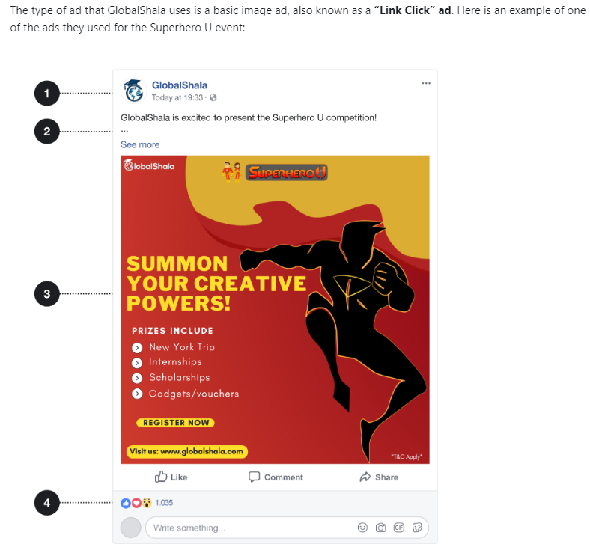
Understanding Superhero U Ad Campaigns
Ads contains
Link to globalshala profile visit
Some descriptive text.
An image that, in this case, links to the Superhero U website.
Buttons to like, comment, and share the ad.
1
2
3
4
Total 11 Campaigns
Target audience : “students” or “educators and principals”
Age target
Interns : 16 to 26
educators and principals : 30 to 60

Slide 6
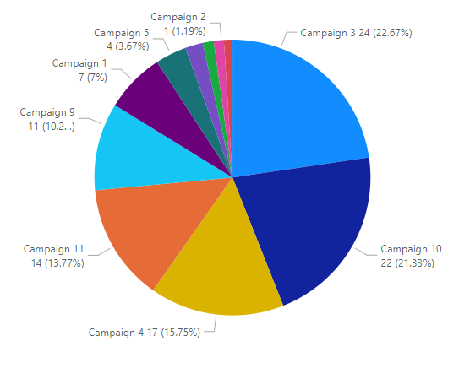
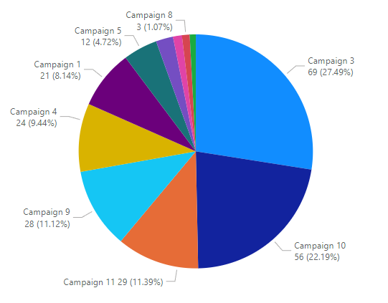
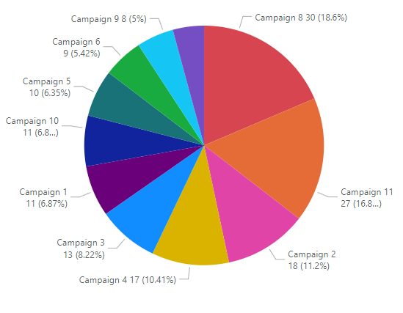
Campaign Analysis
We have analyzed campaigns by
CPC – Cost per click
CPR – Cost per Result CTR – Click through rate Above three important factors
Cost per click
Cost per Result
Click through rate
Lower CPC and CPR values and Higher CTR values indicate effective campaigns.

Slide 7
Campaign Analysis
As per the analysis
When we average the metrics for Campaign 3 (SHU_Students(Australia)) across all age groups, we find:
Average CPC:
7.92
Average CTR:
12.73
Average CPR:
23.11
And also when we average the metrics for Campaign 10 (SHU_Students(UK)) across all age groups, we find:
Average CPC:
7.45
Average CTR:
10.19
Average CPR:
18.65

Slide 8

Campaigns to Discontinue
These averages still indicate that
Campaign 3 (SHU_Students(Australia)) and
Campaign 10 (SHU_Students(UK))
are the least effective campaign overall. It has the highest average CPC and CPR and the lowest average CTR across all age groups, suggesting that it's not performing well compared to the other campaigns. Therefore, Campaign 3 should be considered for stopping or further optimization.

Slide 9

Conclusion
In summary, discontinuing Campaign 3 (SHU_Students(Australia)) due to its inefficiency in engaging the audience and considering alternative strategies is a prudent choice. For Campaign 10 (SHU_Students(UK)), exploring optimizations is recommended to enhance its effectiveness and overall campaign performance. Regular monitoring and testing of these strategies will be essential to achieve better results and ROI in future campaigns..
Based on the averages, Campaign 8 (SHU_Students (Nigeria)) stands out as the most effective campaign. It has the lowest average CPC, the highest average CTR, and a relatively low average CPR across all age groups. This suggests that Campaign 8 has been successful in engaging the audience at a lower cost and generating better click-through rates.
Therefore, Campaign 8 (SHU_Students (Nigeria)) is the most effective campaign in this analysis.

Slide 10
Thank You!

